Slide 1
Analysis of several different methods for trading Tesla stocks with a focus on natural language processing techniques applied to twitter data.
Eilder Jorge García

Slide 2
Content Table
Preparing the data
The Naive NLP approach to sentiment analysis on Twitter data
Other methods and techniques to improve the analysis results
Weighted sentiment analysis
Expanding our sentiment lexicon
Other sentiment analysis tools
Ensemble systems, combining all of the analyzers
Adding negative bias to the analyzers
Amplifying sentiment based on amount of tweets
Establishing more complex money management techniques
Combining Technical Analysis with Sentiment Analysis
Random Forest Classifier for automatic TA predictions
Recurrent Neural Network with LSTM for Price prediction
Conclusions

Slide 3
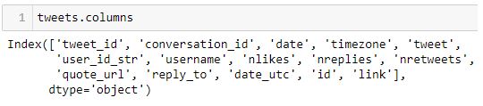
Clean Tweet Data
Redundant
Useless
Not Considered
Date, timezone
Tweet_id, conversation_id, id, link, quote_url, reply_to
User_id_str, username

Slide 4
Other processing
No missing data was found.
Price data was converted into a Pandas dataframe and I set the date as the index for use in the backtesting library.

Slide 5
The Naive NLP approach: Using VADER as is
The VADER library performs sentiment analysis on text and gives us a polarity score.
The compound score combines the polarity into a single number expressing the sentiment.

Slide 6

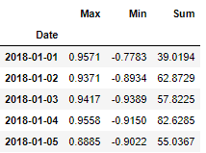
Combining the sentiment data with price

Slide 7
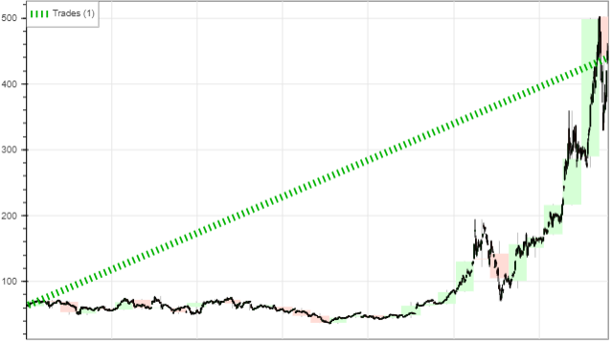
Backtesting the VADER predictions: sum
10000 Cash, 2% commission, no margin, trades are opened on next candle open and only one trade is allowed at a single time.
If our sentiment is positive we buy, if it’s negative we sell.

Slide 8
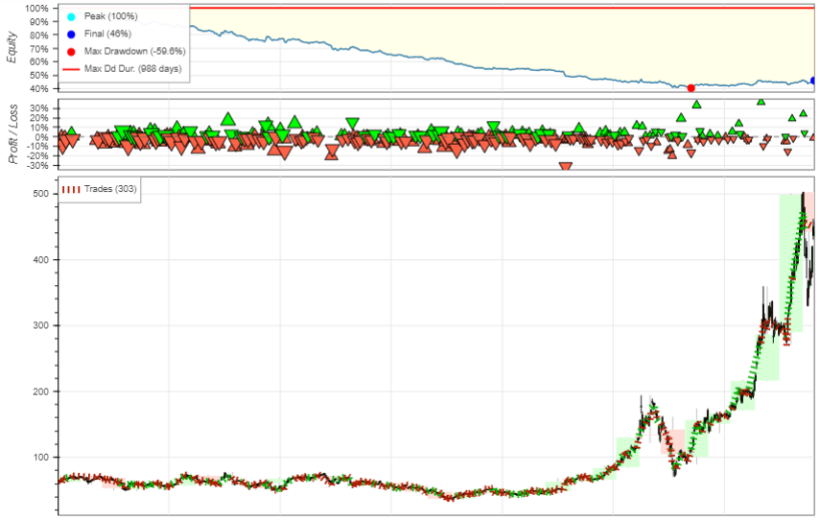
Backtesting the VADER predictions: max and min
If our maximum sentiment is greater than the absolute value of our maximum negative sentiment we buy, and we sell in the opposite case.

Slide 9
Extending our algorithm
Experiment with weights using the number of likes, retweets and replies.
Experiment with the sentiment analyzer lexicon, adding more words and tuning weights for existing words, or trying another sentiment analyzer.
Test on other price data that isn’t extremely bullish to check if the overall tweet sentiment is positive, and if we can confirm that, on average, tweet data is positive, apply a bigger multiplier to negative tweets to offset the positive ones and create some equilibrium.
Experiment with better money management techniques, like trailing stops or incremental positions.
Experiment combining our sentiment with technical indicators.
Experiment combining our sentiment with other ML models such as RNN or random forest ensembles.
Experiment adding the weekend sentiment onto the Monday candle.
Experiment with weights using the username, but this is not scalable to other markets or even other news sources.
Add market specific data, such as the beta of the stock, their fundamental data (such as earnings, etc…), TICK data, compare it with other similar stocks in the sector or aggregate their data, etc…

Slide 10
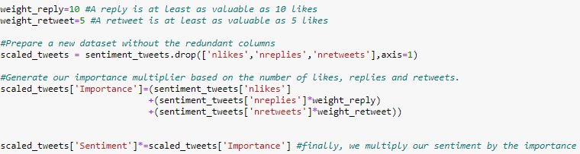
Weighted sentiment analysis
A quick look at the data gives an approximation of 10 and 5 for good optimal values for importance of reply and retweets.

Slide 11
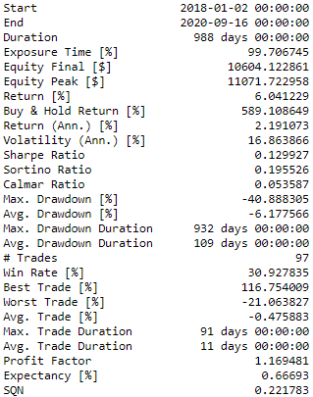
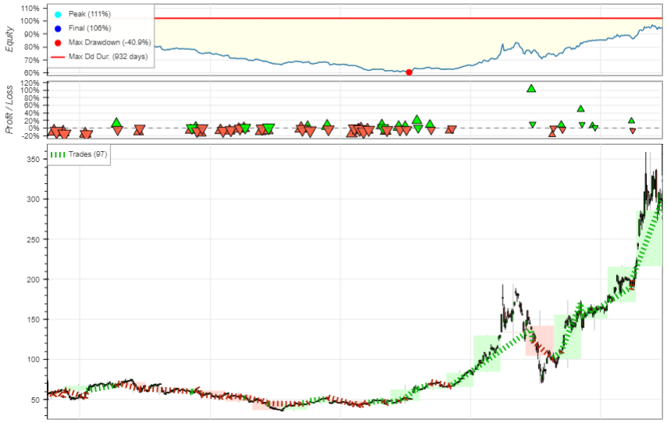
Backtesting the weighted analyzer: sum

Slide 12
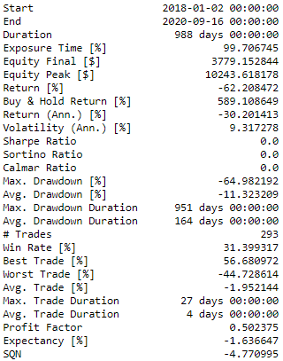
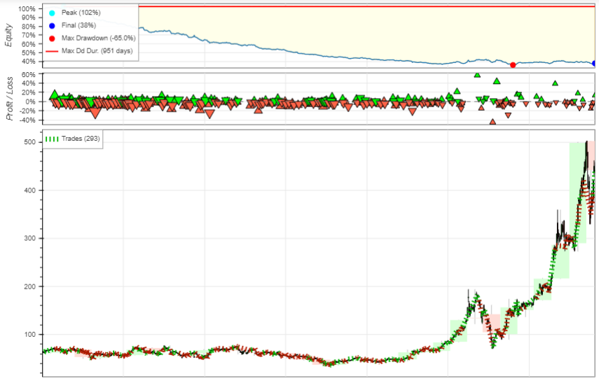
Backtesting the weighted analyzer: max and min

Slide 13
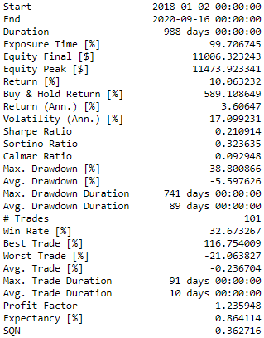
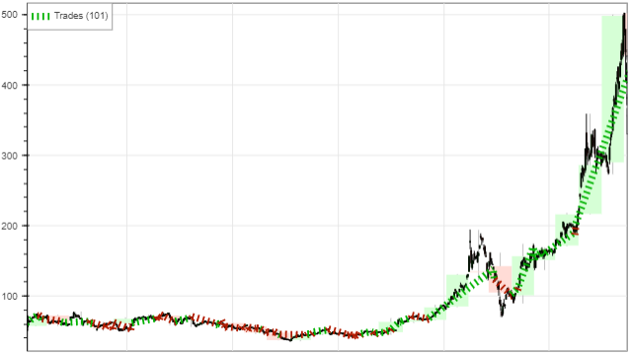
Weighted sentiment analysis: Optimal weights
Grid search analysis return 19/4 for optimal values. Likely due to overfitting to the data, I used 20/5 in the rest of the project.

Slide 14
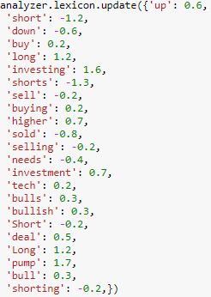
Expanding the Lexicon
Several thousand common words not included in the Lexicon.
Manual examination found some words that could be relevant to trading and that aren’t included.
Results were disappointing.

Slide 15
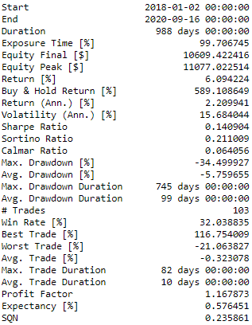
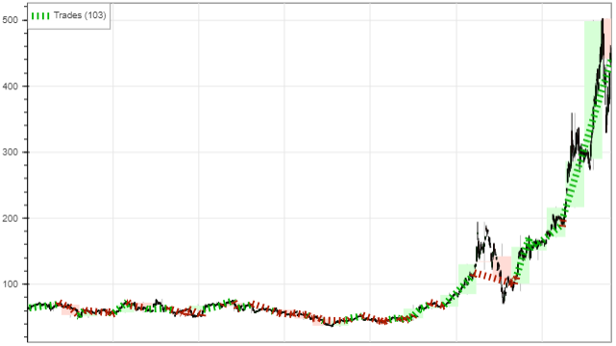
Lexicon Expansion Results

Slide 16
SentiwordNet
Not specialized in Social media data, but very good in many common NLP scenarios.
Incredibly slow to process the text data.
Returns a polarity score we convert to 1 or -1.

Slide 17
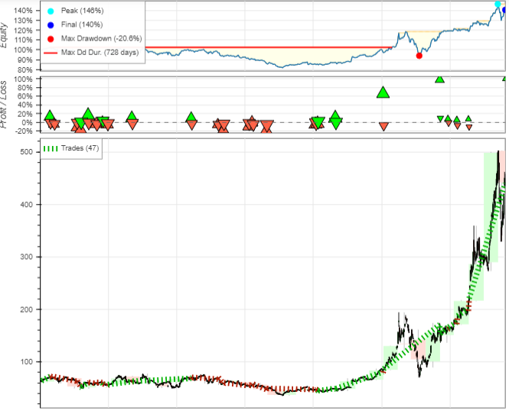
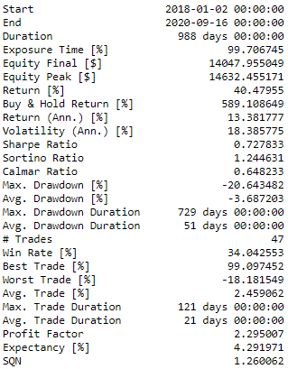
SentiWordNet results

Slide 18
Textblob
Even slower than SentiWordNet.
Very thorough and widely used in many NLP scenarios for sentiment analysis using lexicon approaches.
Produces a polarity score, somewhat resistant to punctuation, but not specialized in messy text data either.

Slide 19
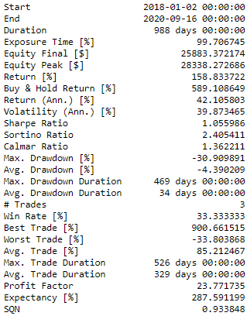
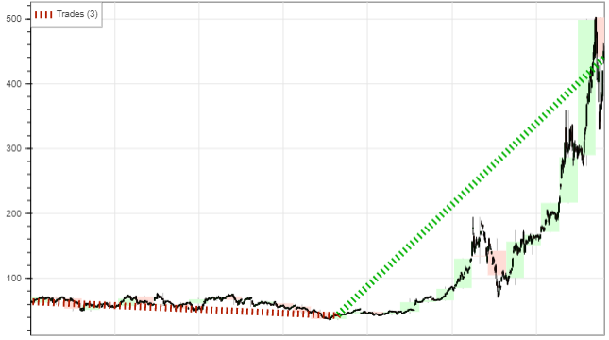
TextBlob Results

Slide 20
Changing our entry and exit conditions
If our overall sentiment is mildly positive and we're not in a long position or in the opposite case, open a trade.
If our overall sentiment falls below a threshold for neutrality, we close the trade.

Slide 21
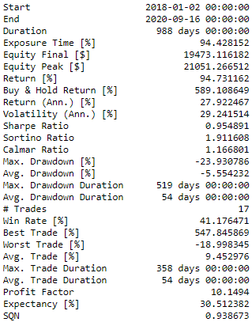
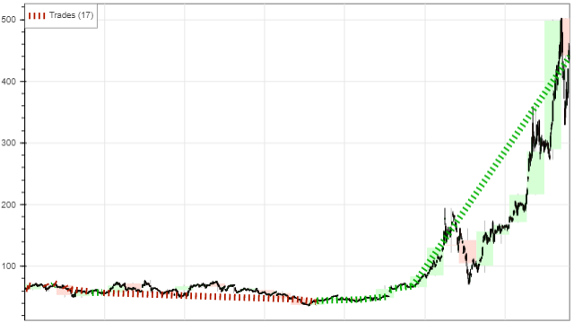
Modified trading conditions result

Slide 22
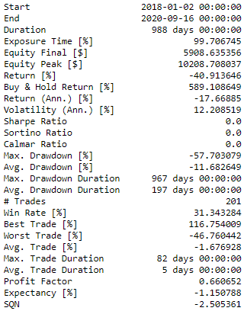
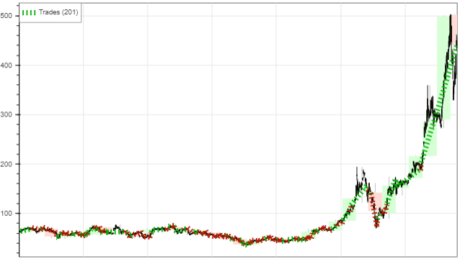
Afinn
Public library for sentiment analysis in Python. Variable results.

Slide 23
Ensemble system: Combining Analyzers
The idea is to combine the sentiment predictions of each analyzer. There are many approaches to this problem.
In the project I separated our data into train data and test data, then scaled the analyzers on the train data, and transformed the test data using those scalers.
With the data properly scaled I just added them together.
We also add a 20% stop loss on our positions to protect from extreme movement.

Slide 24
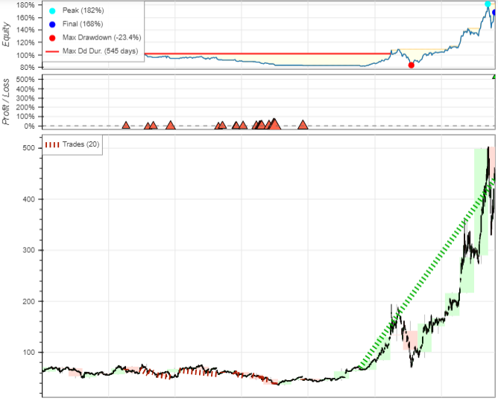
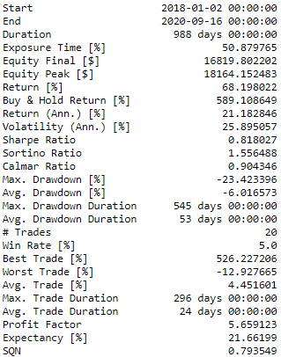
Ensemble system: Result

Slide 25
Negative bias in our analysis
The proposition consists of Tweet data to be inherently bullish, due to people tweeting representing interest in the data, in stark contrast to some company no one talks about.
This means that our sentiment analysis has a bullish bias and we could amplify our negative values so we try to offset that bullish bias.
A small amplification doesn’t make much of an impact, but even a big amplification doesn’t affect the performance of the algorithm too much.

Slide 26
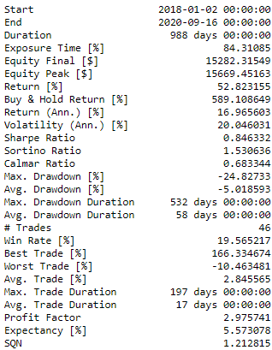
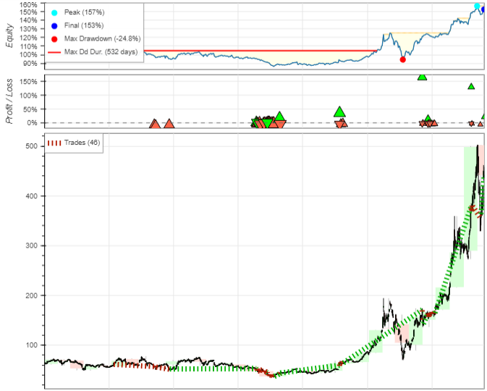
Negative bias results

Slide 27
Amplifying sentiment based on amount of tweets
The idea is simple but powerful. If a day has more tweets then it means there is an underlying event causing people to direct their attention to it.
Due to this, we can take our sentiment analysis scores and increase it based on the number of tweets.
Finally, we would adjust our trading entry positions based on “strong sentiment” instead of “slightly above neutral sentiment”

Slide 28
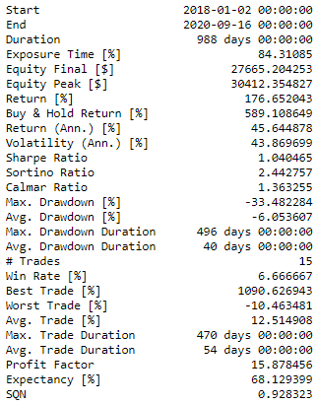
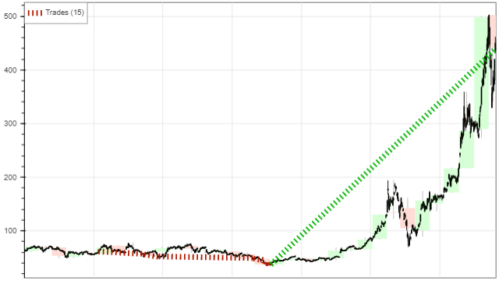
Sentiment amplification results

Slide 29
Varying the money management techniques
Just having a good idea of market direction is a good place to start, but we need to define optimal ways to actually trade in order to maximize the profits.
This is a non-trivial optimization problem where it’s easy to overfit to the data at hand.
Stop loss, trailing stop loss, take profit, sentiment values and incremental positions were analyzed.
In general stop losses don’t make much impact on our P/L but reduce drawdown and risk significantly, while take profit configurations severely reduce our P/L.
Take profit is good on markets without commission and in intraday trades, but can severely cut into your profit due to commission and slippage.

Slide 30
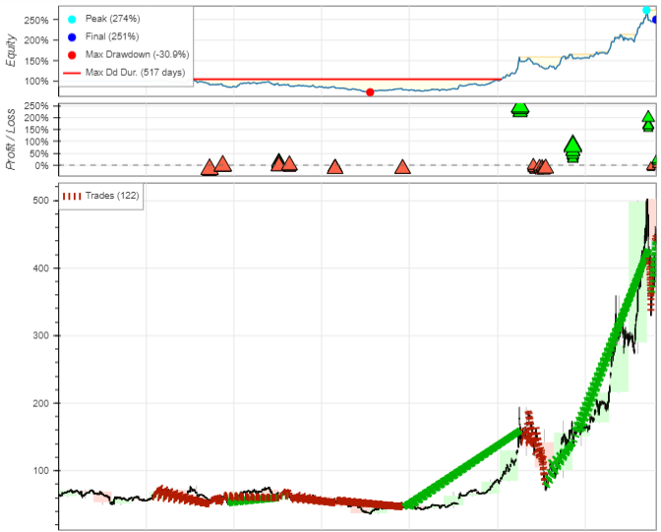
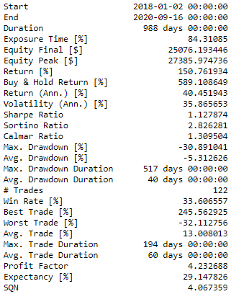
Incremental position with Trail stop results

Slide 31
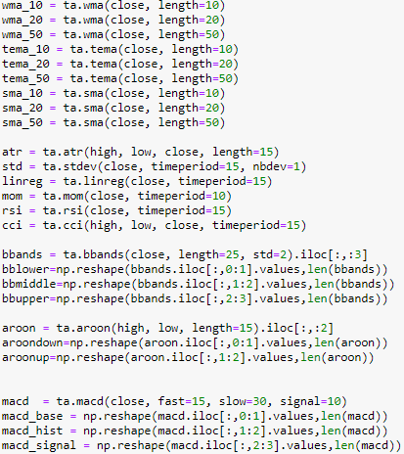
Combining sentiment analysis with TA
Indicators calculated using the pandas_ta library.
Small sub selection of choices, it’s not meant to be exhaustive or to check every possibility.
Setting our stop losses at the Bollinger bands and checking for fast moving average over slow moving average.
Less data to test due to the need to calculate the indicators.

Slide 32
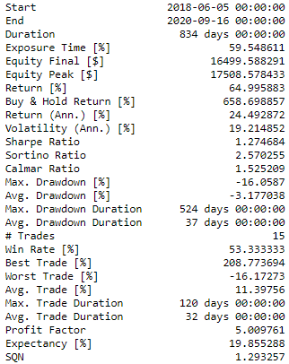
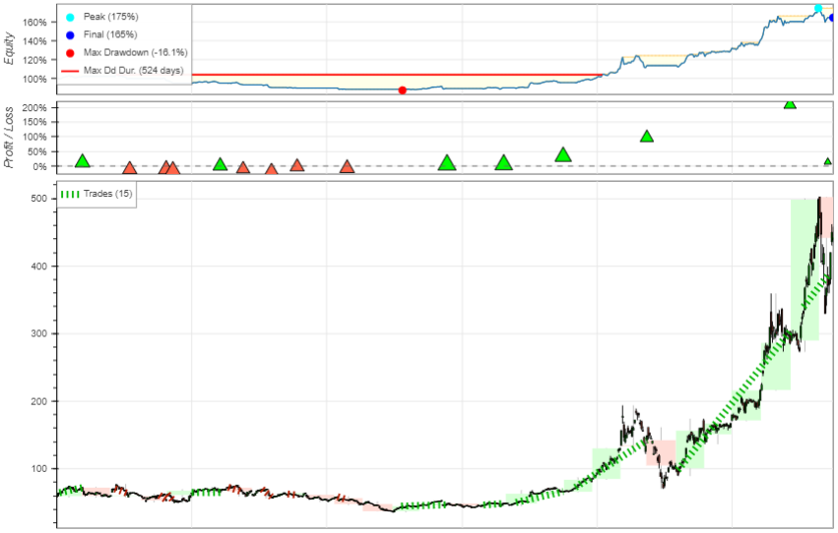
TA with sentiment results

Slide 33
Random forest applied to technical analysis
Defining a set of rules and combination of elements for indicators to predict the future prices can be extremely difficult and time consuming.
Machine learning methods based on classification techniques could be used to automatically determine rules based on those indicators that help them predict future prices.
Random forest is one good choice because it features automatic feature selection using information gain by calculation of the entropy.
We can also build a classifier not only for next candle, but for the next weekly candle as well.

Slide 34

Configuring the random forest
Use 200 samples for training because we need to keep at least a decent amount of candles for testing trades and there is only 626 samples.
Make a simple binary classifier instead of a regressor as we are only interested in price going up or down, and not the exact amount.
Using 10000 trees with a maximum of 15 features out of 33.

Slide 35
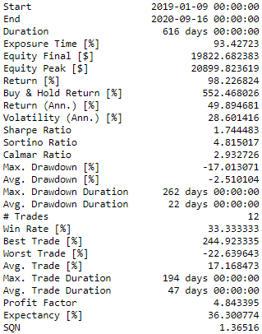
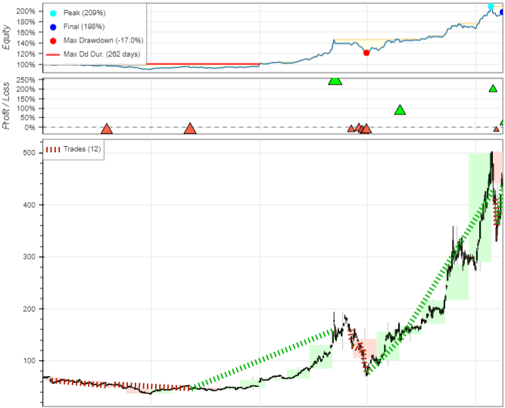
Random forest with sentiment results
If sentiment is positive and our random forest predicts increase we buy, and we sell if our sentiment is negative and it predicts decrease.

Slide 36
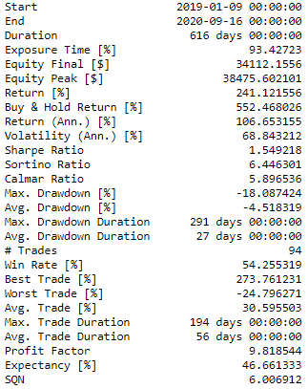
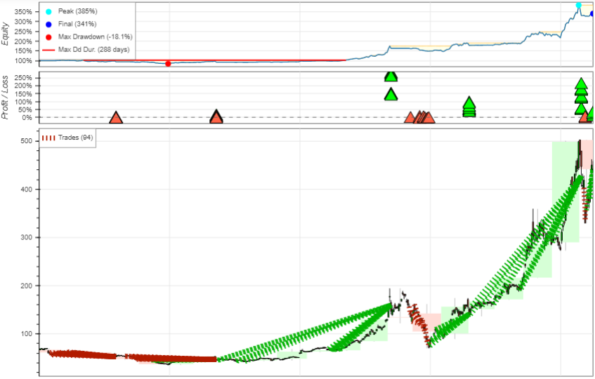
No commission with incremental positions

Slide 37
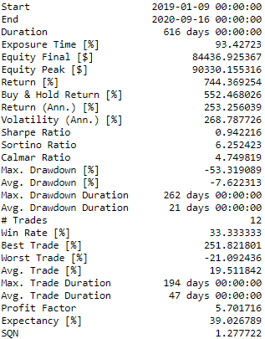
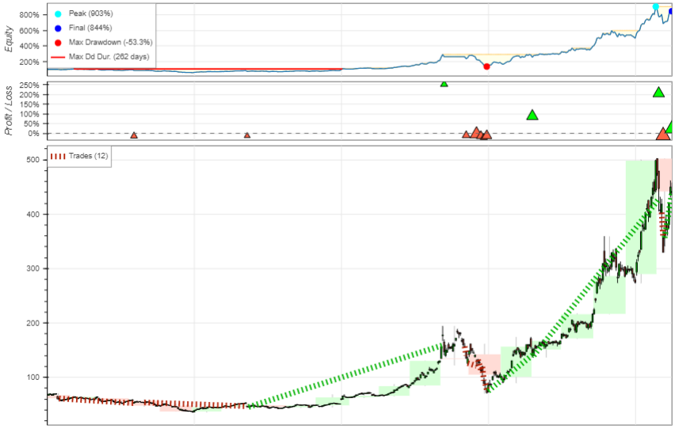
No commission, all equity used

Slide 38
RNN: Recurrent neural networks
Recurrent neural networks and in particular the LSTM (Long Short Term Memory) layer allows a deep learning network to learn a structure using sequences over time.
It requires a specific format of the data, that means using sequences: In the case of 1,2,3,4,5,6,7,8,9,10 we would need to convert it to: (1,2,3,4) -> 5 and (2,3,4,5) -> 6… (6,7,8,9) -> 10
This means we need to define our training sample and our sequence length, often called window size or step size.
We define the number of training data as 200 and the length of the sequences as 50.

Slide 39
RNN: Types
Configuring a neural network is a highly iterative process that consumes time and resources.
There are many layers and configurations that we can experiment with in order to obtain better values but our training sample is very small so it’s likely the network won’t learn much anyways.
We experiment with Univariate RNN with a LSTM Layer and a Dense layer. We also experiment with stacking LSTM layers and with using Bidirectional LSTM layers.

Slide 40
Trade conditions
At this moment the trade conditions are very strict because we are using a ensemble of sentiment analyzers to determine sentiment and a random forest classifier to automatically do TA and a RNN to determine future prices.
The final conditions tested were to open trades if our sentiment was positive and we get future prices predictions higher than our current ones and our random forest predicts higher candles the next day and the next week. Or to short if the opposite happens.
10000 Equity and 2% commission with trades being calculated on the open of the next candle with only one trade open at a time.

Slide 41
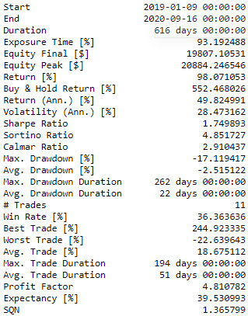
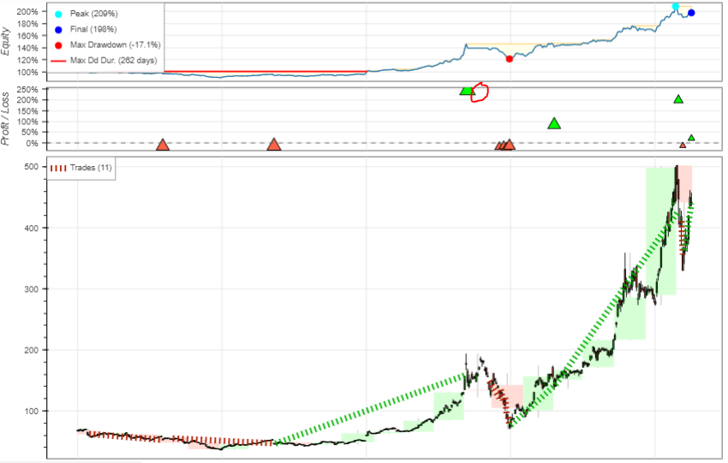
Final RNN + RF+ Sentiment analyzer Results

Slide 42
Conclusions
Lack of data in the analysis lead to biased results that are more likely than not overfitting slightly to the data.
NLP proves to be very effective in determining overall direction but needs to be combined with other systems to filter out entering at bad moments.
NLP analysis takes a considerable amount of time and ensemble systems can help offset the mistakes of some of the analyzers.
TA is very useful, but can take a considerable time and might overfit to the data if done manually. ML algorithms can help use TA without introducing human Bias.

Slide 43
Conclusions: Future lines of research
Exploring other NLP alternatives.
Modifying our Ensemble systems.
Portfolio management, diversification and money management techniques.
Extended TA.
More deep tuning of the neural network for better price prediction.
Exploring multivariate approaches to the RNN.
Multiple time frame analysis.
Classifier of classifiers: Defining entry and exits automatically with ML methods.
Reinforcement learning.

